Slide 6
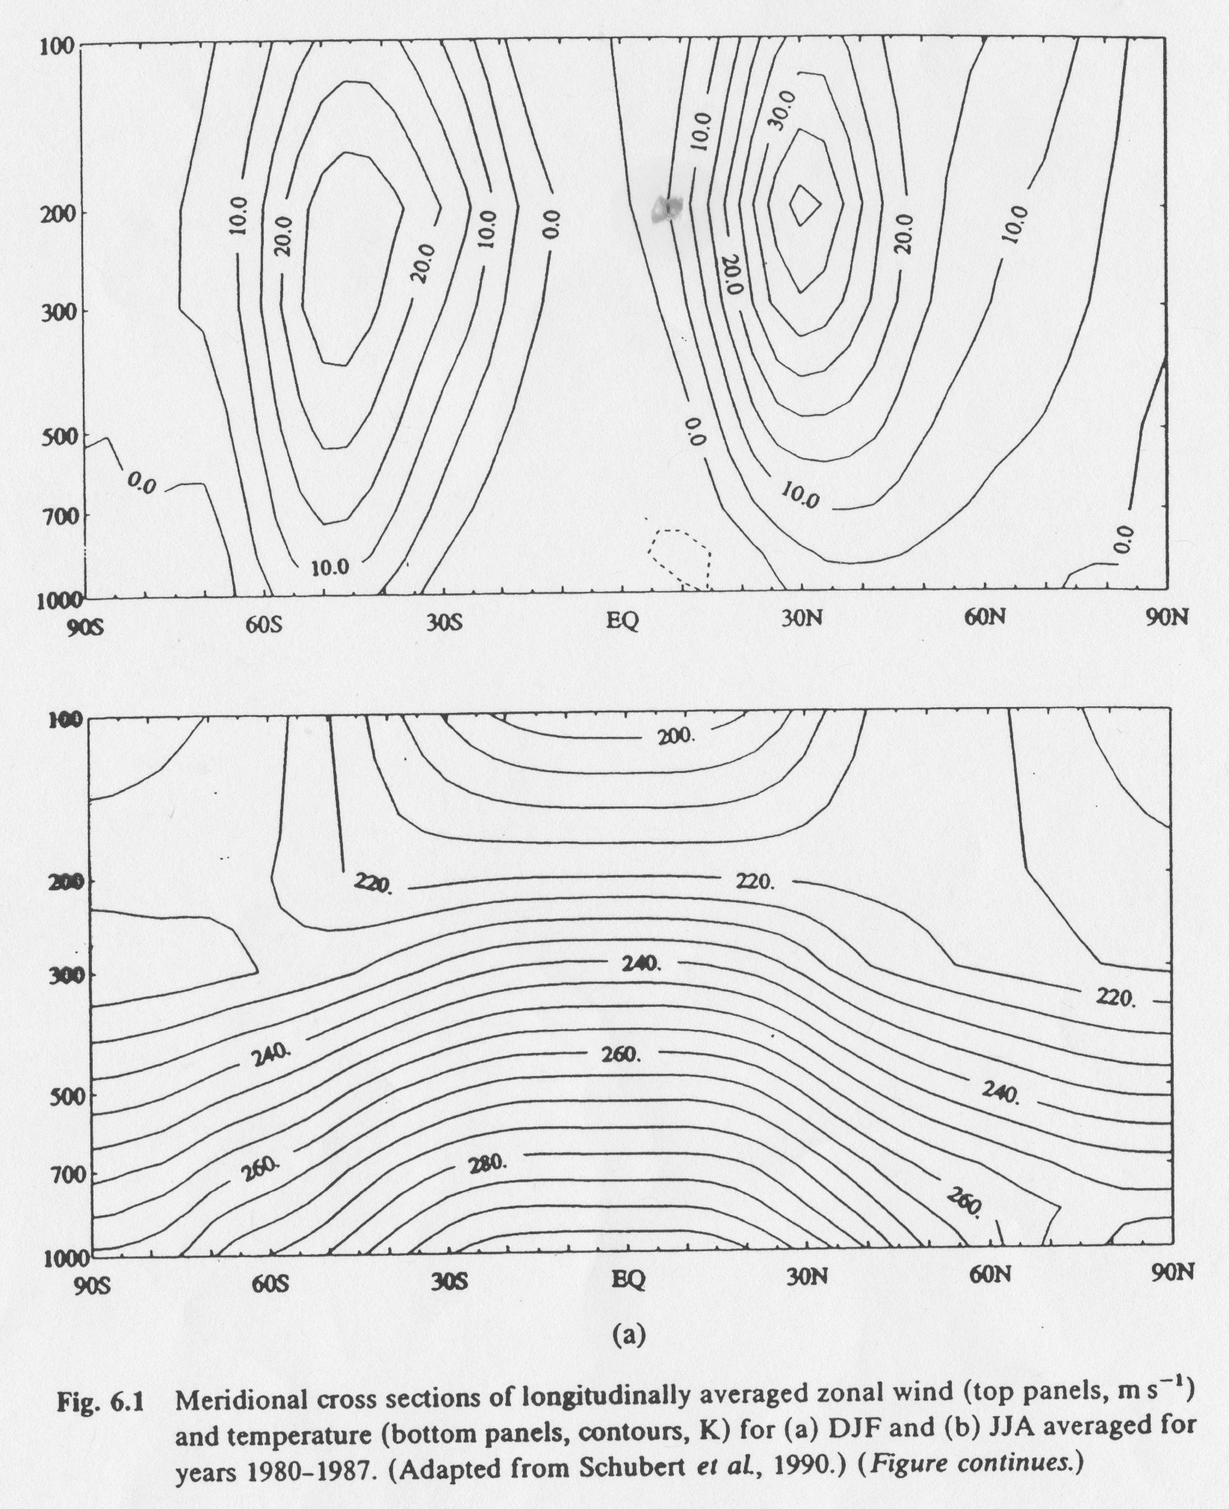
$\frac{∂u_{g}}{∂z}$ = -$\frac{g}{fT}\frac{∂T}{∂y}$

Slide 9
DJF 850-1000 hPa Thickness 850-1000 hPa Thickness anomaly
contour interval = 6 m
(Gill Fig. 7.8)

Slide 10
January 200 hPa Z
Geopotential Height
contour interval 100 m

Slide 11
1 db = 0.1 bar = 100 hPa = 0.1 atm = 1 m (i) is relative to ~1 km depth (ii) is 1-2 km thickness

