Slide 3
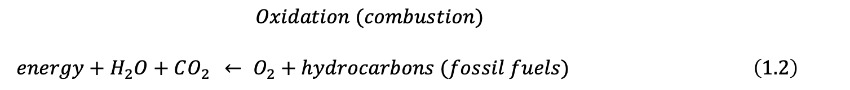
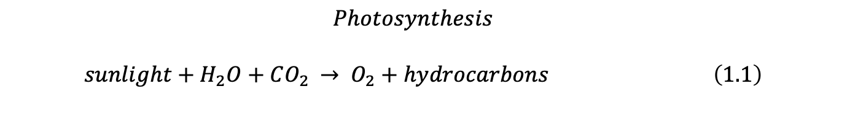
$$Photosynthesis$$
$$sunlight+H_{2}O+CO_{2 }→ O_{2}+hydrocarbons \left(1.1\right)$$
$$Oxidation (combustion)$$
$energy+H_{2}O+CO_{2 } ← O_{2}+hydrocarbons (fossil fuels) \left(1.2\right)$

Slide 4
Figure 1.3. Variations over the past 420,000 years in the 3200-m deep ice core from Vostok, Antarctica [Petit et al. 1999, 2001] of a) Deuterium anomaly (pptv, left axis), with estimated global temperature anomaly (Kelvins, right axis), b) carbon dioxide (ppmv), and c) methane (ppbv) [from www.ncdc.noaa.gov/paleo].

Slide 5
Thermosphere
XUV < 0.2 μm
Mesopause
Mesosphere
Stratopause
UV 0.2-0.3 μm
Stratosphere
tropics
U.S. Standard Atmosphere
Tropopause
VIS + near IR 0.3 – 2.0 μm
Troposphere

Slide 6
Altitude (km)
lower pressure
O
Air Parcel
Pressure Gradient Force
Gravity
higher pressure
Pressure (hPa)
Density (kg / m³) * 1000

Slide 7
Depth
(m)
Density (kg / m³)
Pressure (atmospheres)

Slide 8
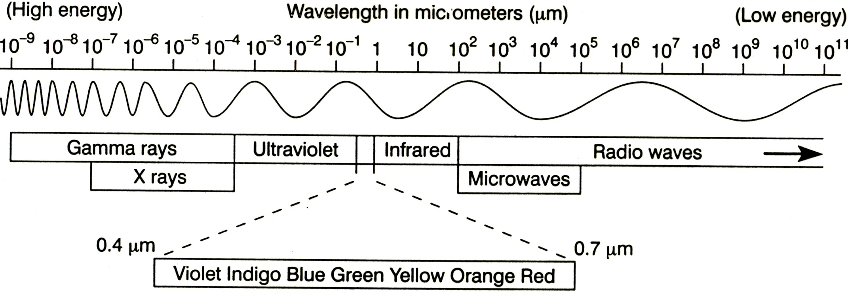
Figure 2.1. The electromagnetic spectrum.

Slide 9
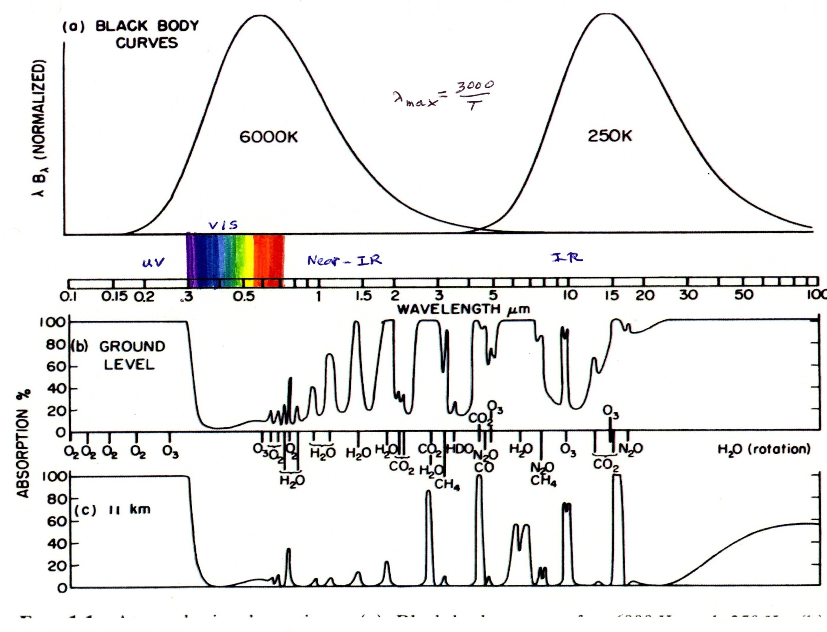
Figure 2.2. a) The solar and earth emission spectra, b) percent absorption for the whole atmosphere, and c) percent absorption for the part of the atmosphere that lies above 11 km.

Slide 10
Incoming
Reflected
Space
100
30
Latent and
Sensible Heat
Transport
70 emitted up
Atmosphere
20 absorbed
(255 K)
70 emitted
down
30
Surface
50 absorbed
90 emitted
(288 K)
Solar Radiation
Infrared Radiation
Air Motions
Figure 3.1. The global average vertical energy transfer processes between space,
the atmosphere, and the surface, including solar radiation (left), infrared radiation
(middle), and vertical transport by atmospheric motions (right).

Slide 11
Why Are The Poles Cold ?
}
Less W m⁻²
}
More W m⁻²
Due to the spherical shape of the earth, the sun’s rays
are concentrated in the tropics and spread out at the poles.

Slide 12
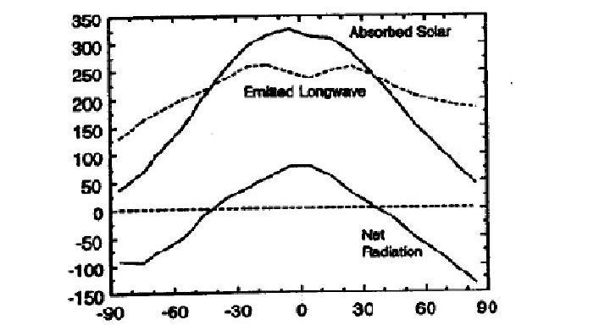
Figure 3.2. Annual and zonal average absorbed solar (solid) and emitted longwave (dashed) radiation in W m². The difference between absorbed solar and emitted infrared radiation, the net radiation into the earth system, is shown below.

Slide 13
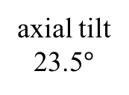
Axial Tilt, Elliptical Orbit, and the Seasons
Mar 21
Equinox
axial tilt
23.5$°$
152 x 10⁶ km
147 x 10⁶ km
June 21
Solstice
Dec 21
Solstice
Sept 21
Equinox
A conundrum: The earth receives ~7% more radiation from the sun
on January 4 compared to on July 4, so why is the earth’s average
temperature less in January than in July?

Slide 14
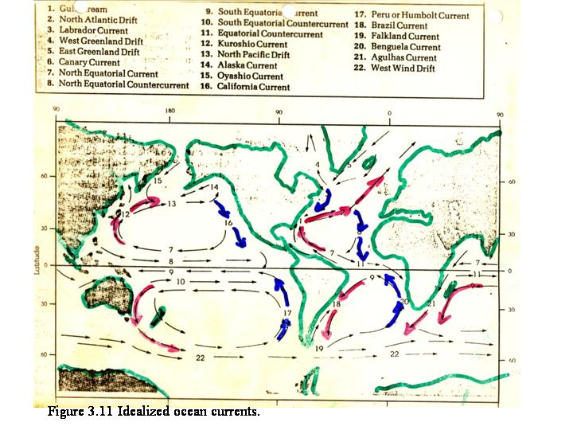
Figure 3.12 Idealized ocean currents [Ahrens].

Slide 15
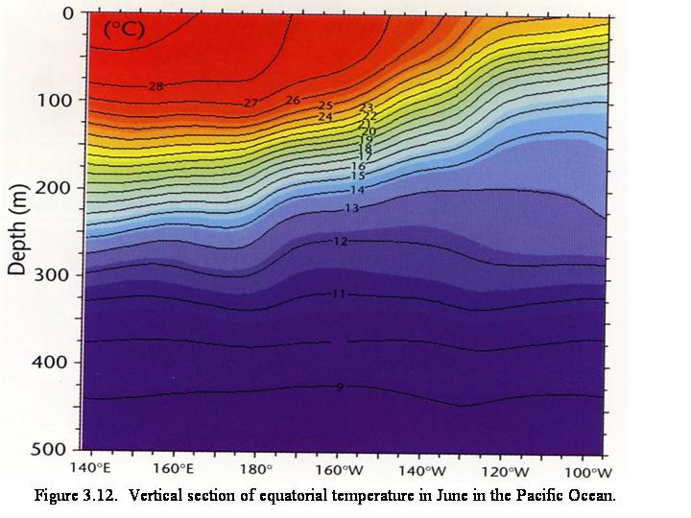
Figure 3.13. Vertical section along the equatorial Pacific showing the sloping thermocline, contour interval 1 K [www.cpc.noaa.gov].

Slide 16
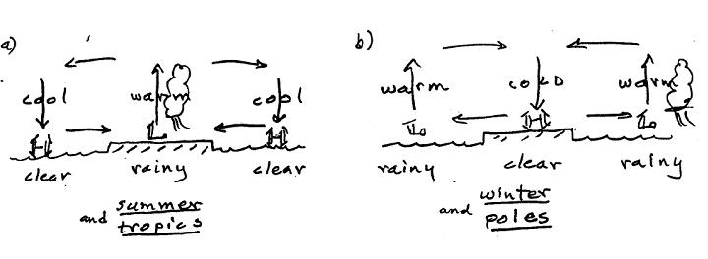
Figure 3.7. Idealized monsoon circulations corresponding to a) summer and
the tropics, and b) winter and polar regions.

Slide 17
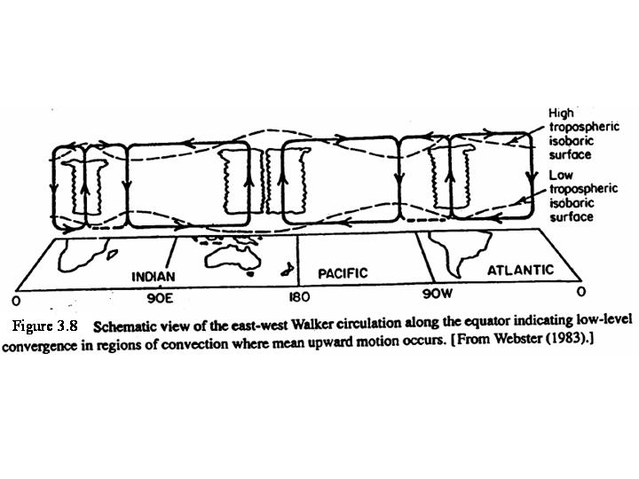

Slide 18
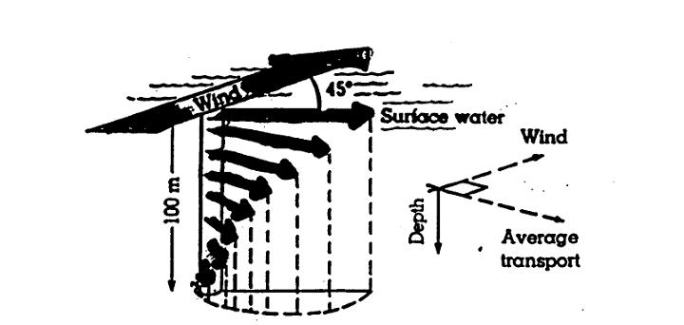
Figure 3.11. The Ekman spiral in the upper layer of the ocean for the Northern
Hemisphere [Ahrens].

Slide 19
Order-one interactions between the atmosphere and the ocean
Ocean temperature anomalies
heat and cool the atmosphere
SSTs
wind
currents
Wind stress causes currents,
ocean gyres, upwelling
evap. precip
Latent heat transport
linked to ocean
salinity
saltier fresher
Extra heat and CO₂ stay
in ocean for ~1000 yr
Heat storage
CO₂

Slide 20
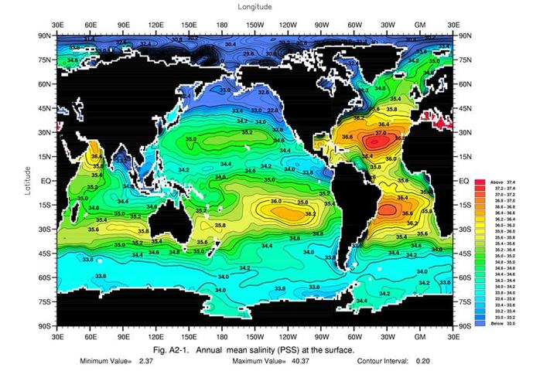
Figure 3.14. Average surface salinity during August, contour interval 0.2 ppt
[World Ocean Atlas 2001].

Slide 21
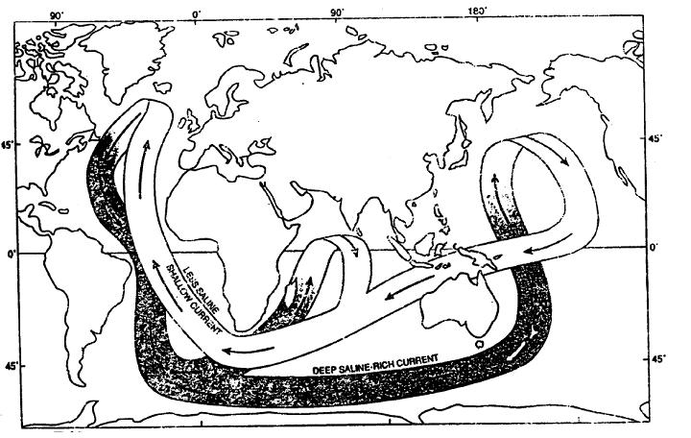
Figure 3.16. Idealized “conveyor belt” view of the thermohaline circulation, with sinking
in the North Atlantic, spreading throughout the deep ocean, rising, and return at the surface.

Slide 22
La Ni$\tilde{n}$a
El Ni$\tilde{n}o$
Warm
Warm
Cold
Indonesia
Peru
Indonesia
Peru
Strong Walker Circulation
Steeply-sloping thermocline
Cold SST/dry near Peru
Wet near Indonesia
Large Tahiti-Darwin SLP diff.
Weak Walker Circulation
Flat thermocline
Warm SST/wet near Peru
Dry near Indonesia
Small Tahiti-Darwin SLP diff.

Slide 23
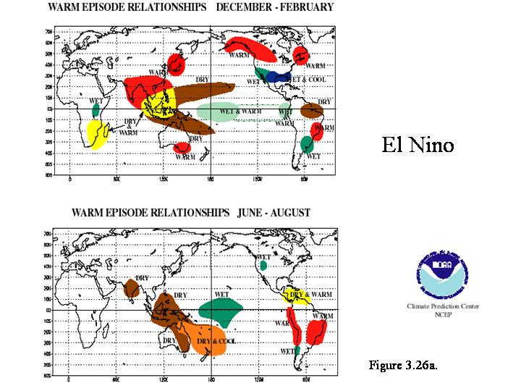
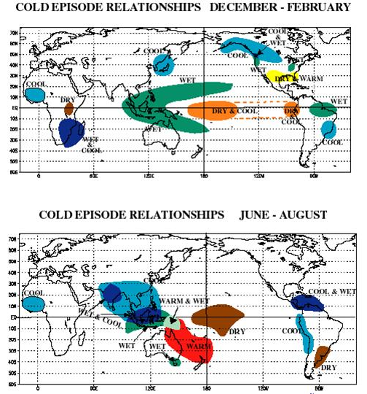

Slide 24
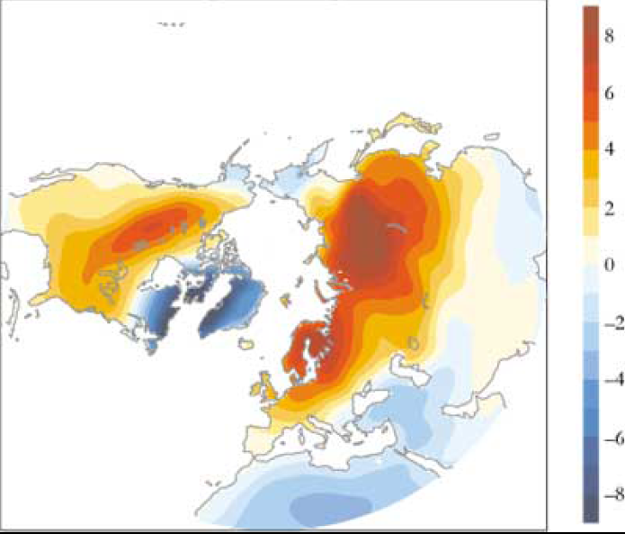
Surface Air Temperature Differences
High – Low NAM index
ºC
Wallace and Thompson, 2002, Phys Today, Figure 3

Slide 25
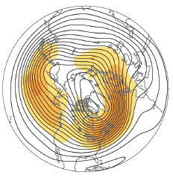
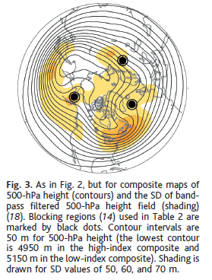
High Index NAM
Low Index NAM
500 hPa
Thompson and Wallace 2001

