Slide 1
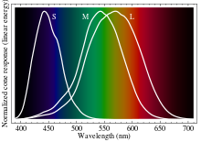

Slide 2
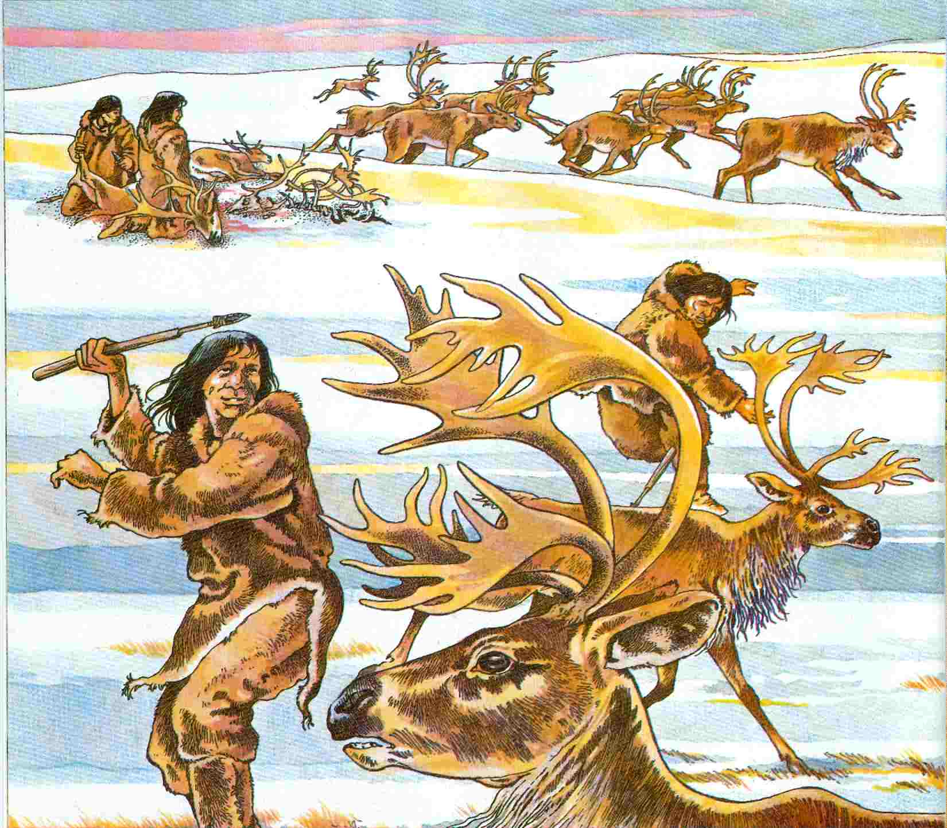

Slide 3
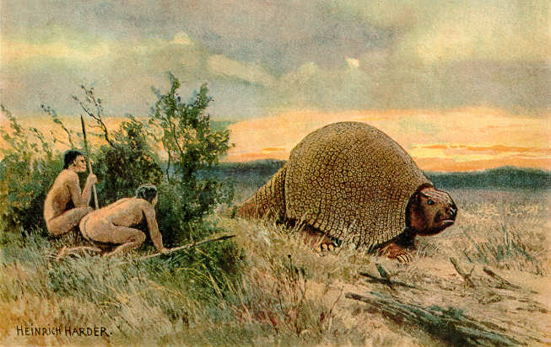

Slide 4
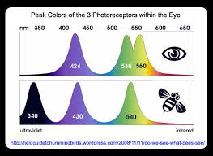

Slide 5
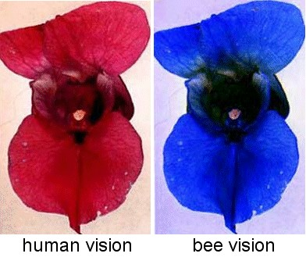

Slide 6
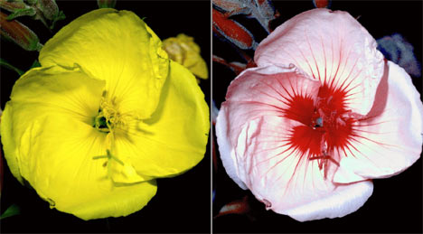

Slide 7
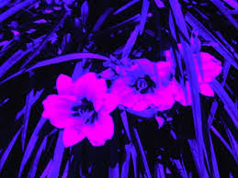

Slide 8
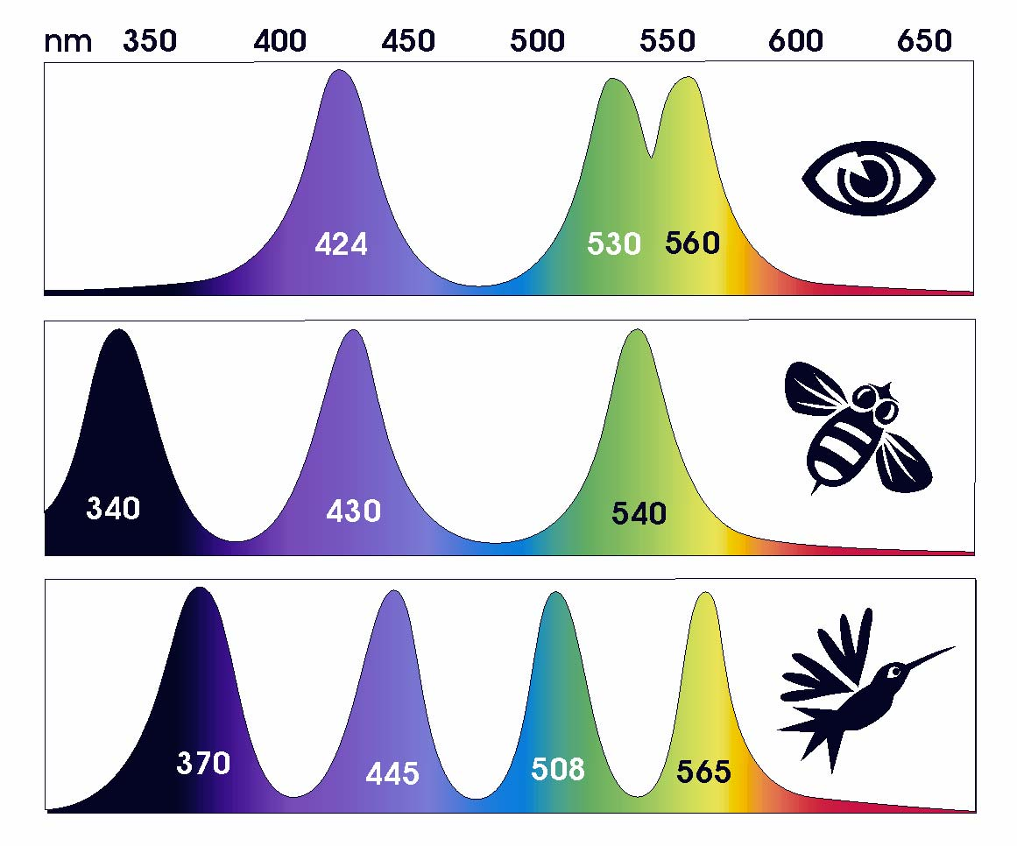

Slide 9
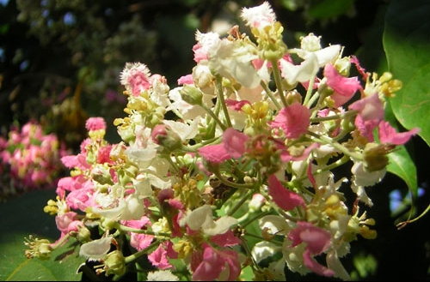
"Banisteriopis-caapi-flowers-lg" by Rafael Guimarães dos Santos - www.neip.info.
Licensed under FAL via Wikimedia Commons –
http://commons.wikimedia.org/wiki/File:Banisteriopis-caapi-flowers-lg.jpg#mediaviewer/
File:Banisteriopis-caapi-flowers-lg.jpg

Slide 10
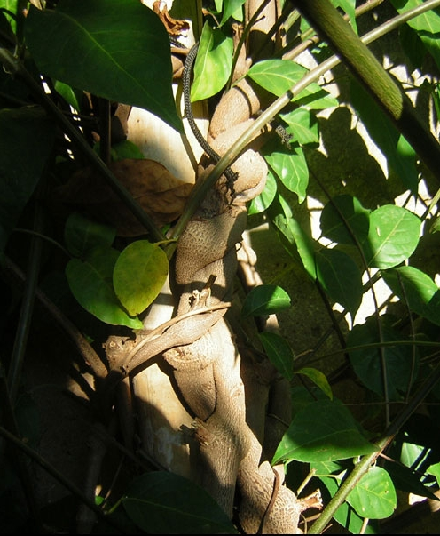
"Banisteriopis-caapi-vine"
by Rafael Guimarães dos Santos
www.neip.info.
Licensed under FAL via Wikimedia
Commons - http://commons.
wikimedia.org/wiki/File:
Banisteriopis-caapi-vine.jpg#
mediaviewer/File:Banisteriopis
-caapi-vine.jpg
Ayahuasca, caapi, yaga
"vine of the soul" in Quechuan,
5 liana vines – 5 noumenal visions,
Wade Davis One River

Slide 11
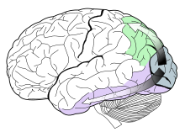
Visual pathways in the human brain. The ventral stream (purple) is important
in color recognition. The dorsal stream (green) is also shown.
They originate from a common source in the visual cortex.

Slide 12
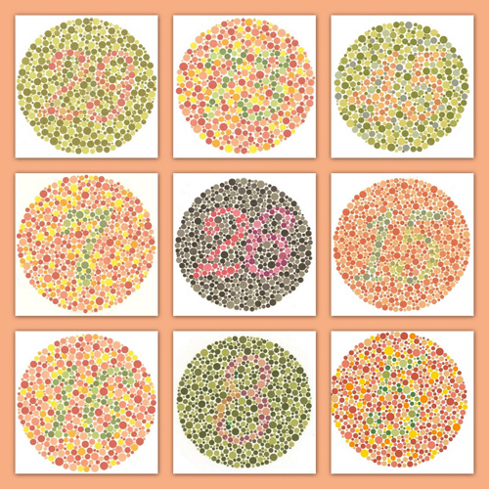
Ishihara
Test Images

Slide 13
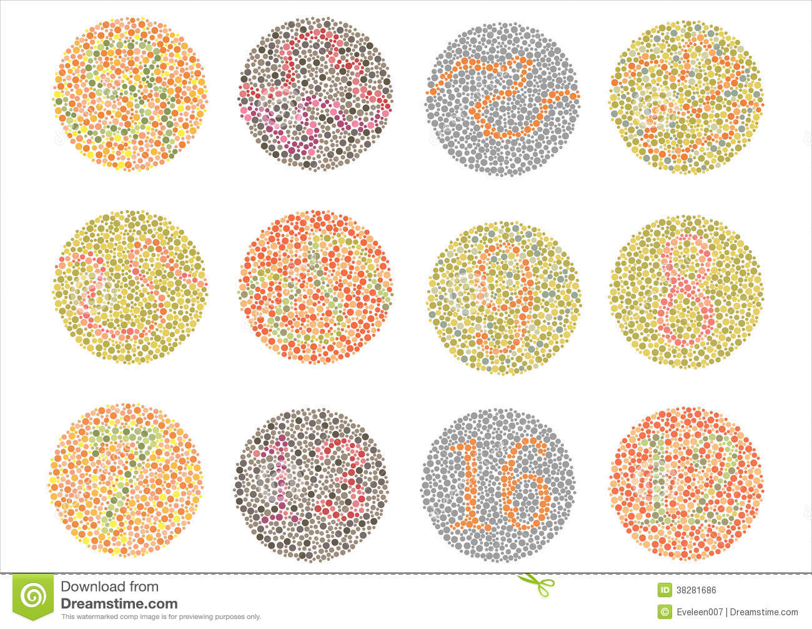

Slide 14
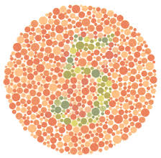

Slide 15
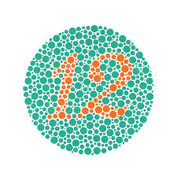

Slide 16


Slide 17
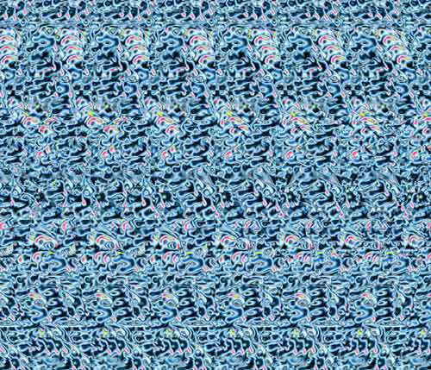

Slide 18


Slide 19


