Slide 1
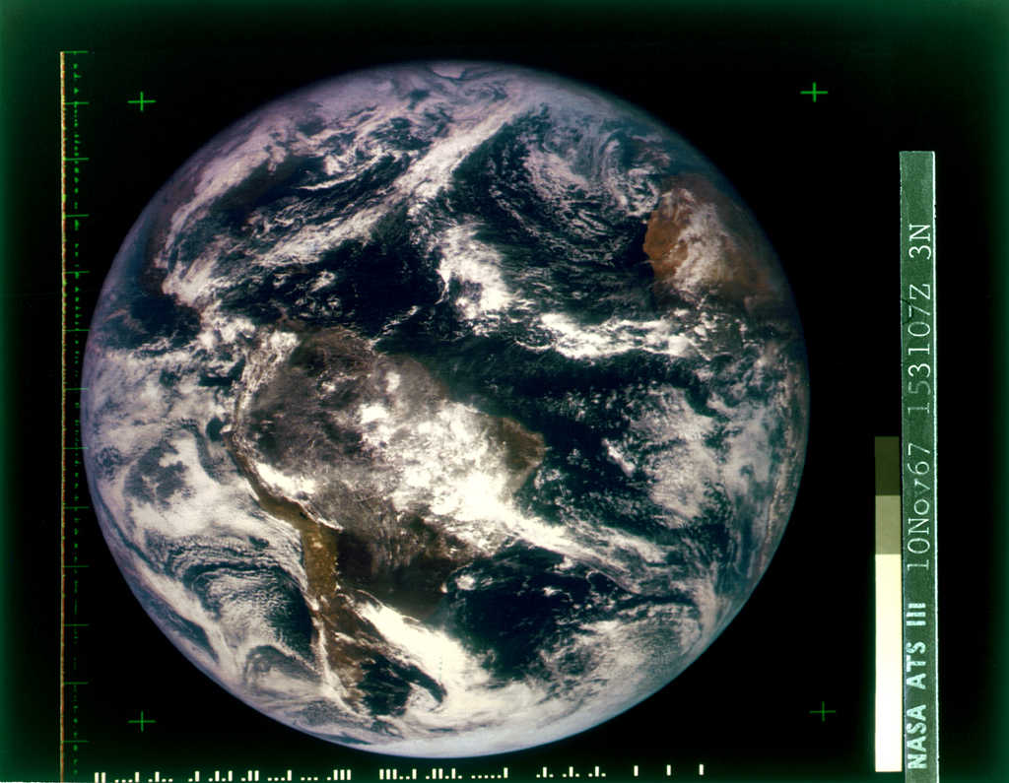
ATS-3 s satellite
10 November 1967

Slide 2
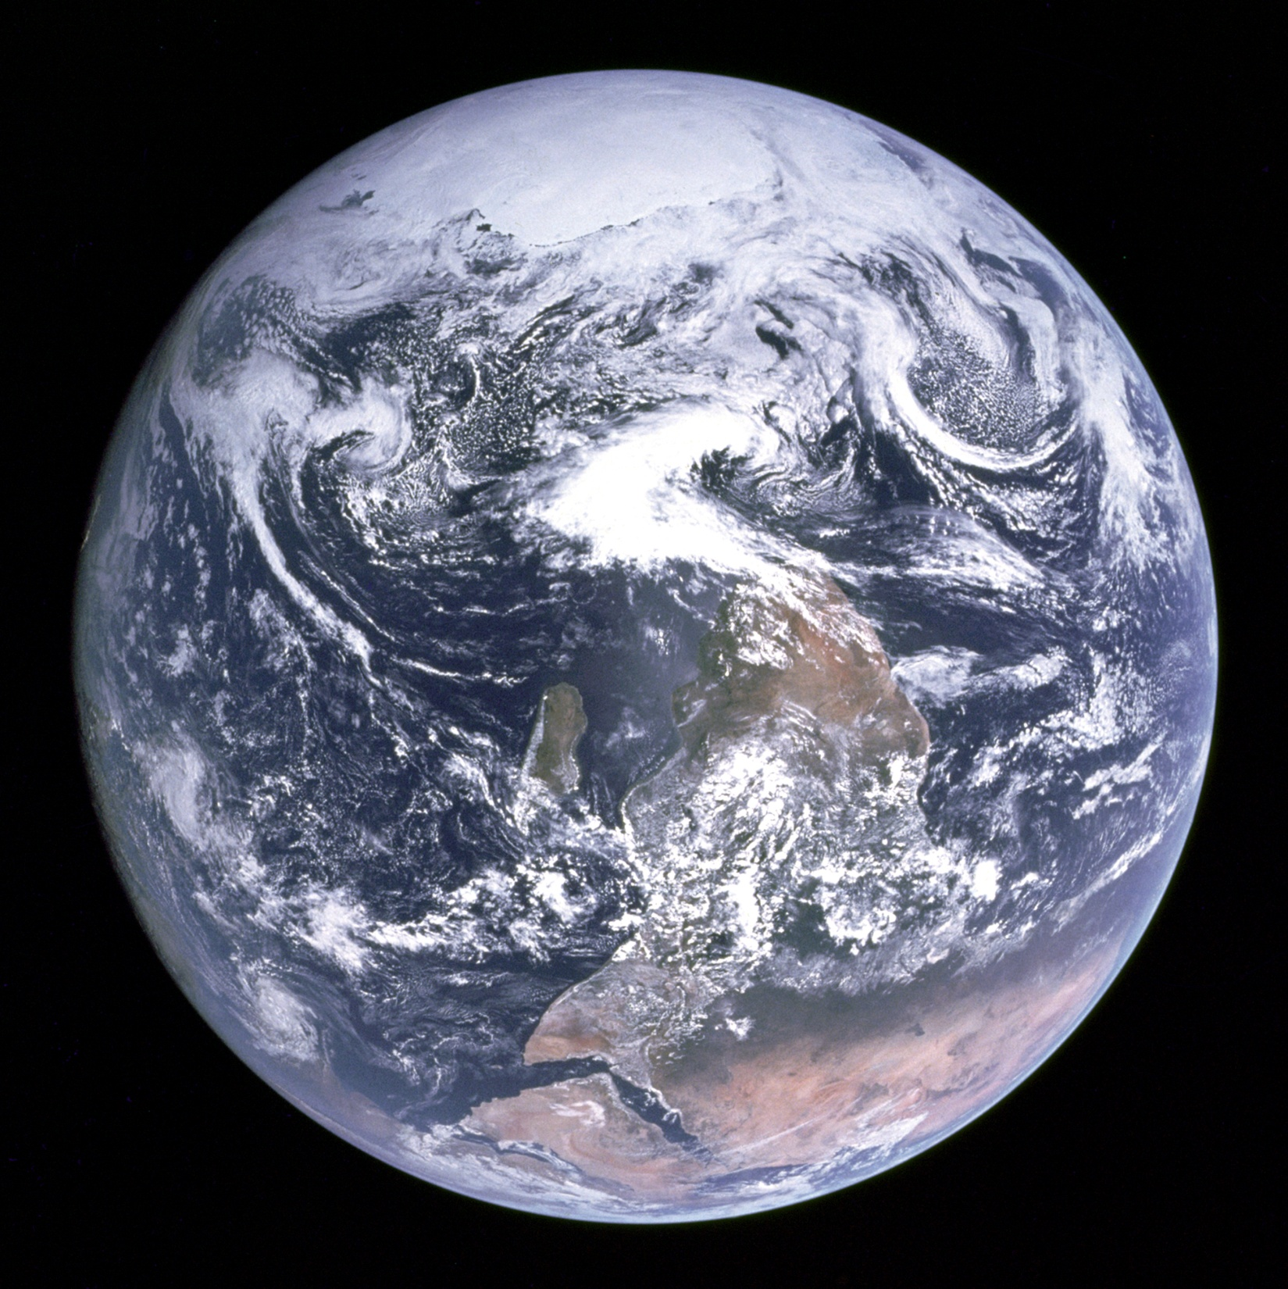
Apollo 17
December 7, 1972

Slide 3
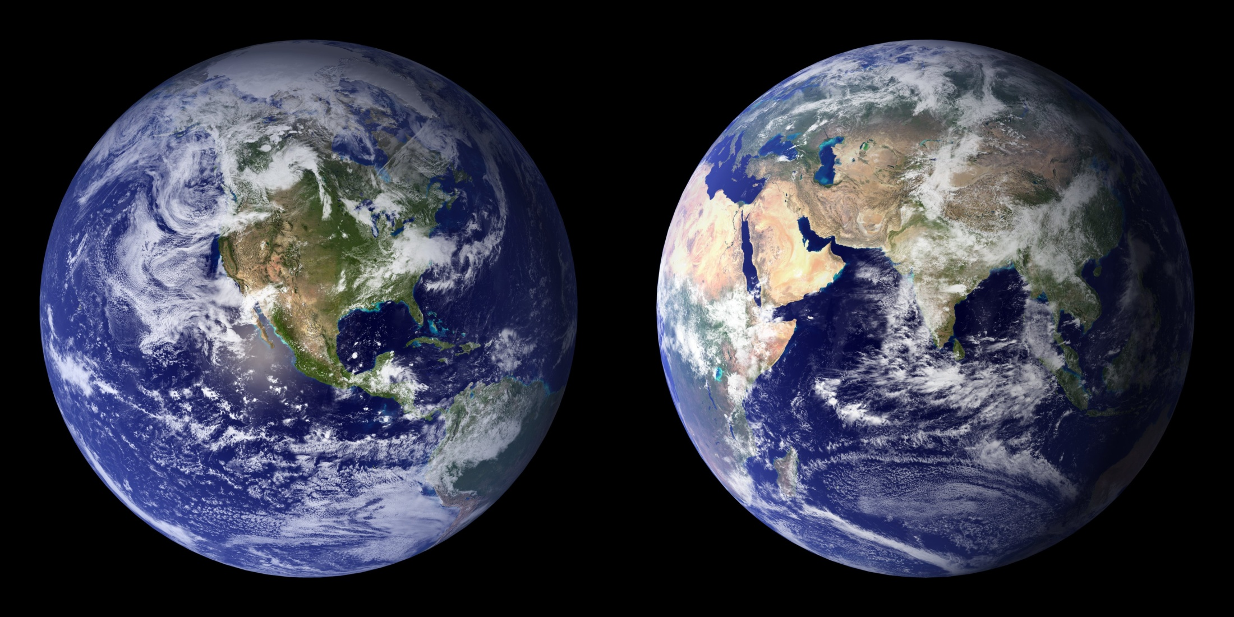
2001 NASA composite 2002

Slide 4
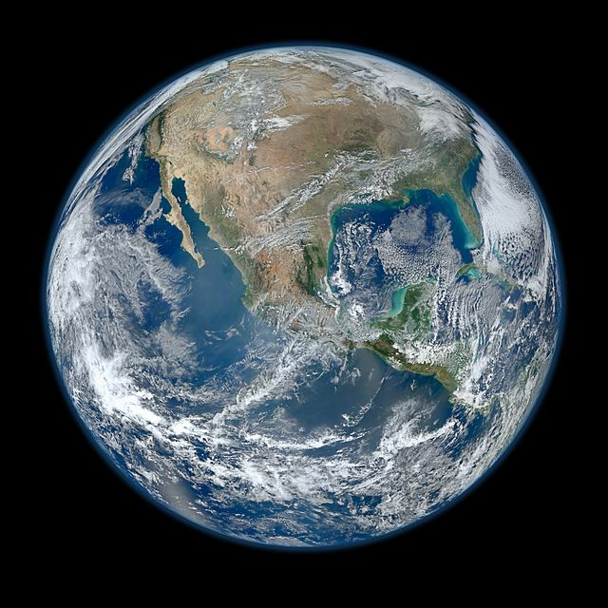
826 km altitude
4 January 2012
Suomi NPP satellite , Visible/Infrared Imager Radiometer Suite or VIIRS.

Slide 5
http://www.ssec.wisc.edu/data/us_comp/

